Slide 1
Virtual AskQC Office Hours
Getting a fix on fixed field elements
OCLC Metadata Quality
October 2021

Slide 2
Housekeeping
This session is being recorded

Slide 3
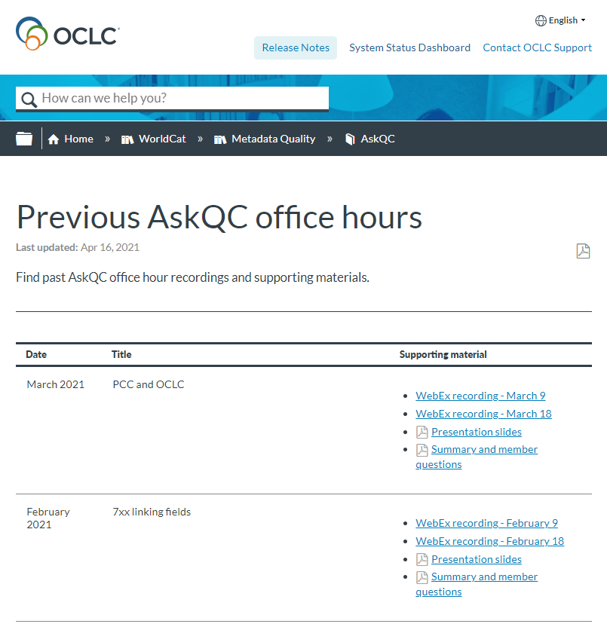
Housekeeping
This session is being recorded
All session recordings, slides, and notes are available at oc.lc/askqc

Slide 4
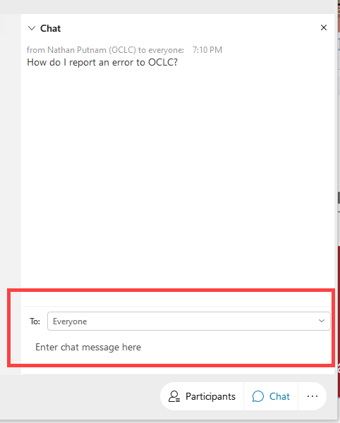
Housekeeping
This session is being recorded
All session recordings, slides, and notes are available at oc.lc/askqc
Enter questions in chat to “Everyone” at any time during the presentation

Slide 5
Housekeeping
This session is being recorded
All session recordings, slides, and notes are available at oc.lc/askqc
Enter questions in chat to “Everyone” at any time during the presentation.
After the session, you will be directed to a brief, optional survey

Slide 6
On the call today
Shanna Griffith
Cynthia Whitacre
Jay Weitz
Database Specialist
Senior Metadata Operations Manager
Senior Consulting Database Specialist
Hayley Moreno
Charlene Morrison
Database Specialist
Database Specialist

Slide 7
Getting a fix on fixed field elements
Jay Weitz
Cynthia Whitacre

Slide 8
Elements common to all/most formats
Leader
001
005
006
008
Photo on this slide and on the previous slide available via Creative Commons license
Notes:
Today we'll plan to cover all the MARC fixed field elements that are common to either all or most of the bibliographic formats plus some related fields that display as part of the traditional OCLC fixed field. We'll also cover the 006 field along with the elements that are common to both the 008 and 006 fields, along with the 001 and the 005 fields. We will not cover elements that are only used in specific bibliographic formats such as the Frequency used only in Continuing resources or Technique used only in Visual Materials. We're tentatively planning a session in 2022 that will cover those elements that we do not cover today.

Slide 9
Leader/05 Record Status (Rec stat)
System supplied; cannot be edited
Default: n (new)
Other values:
c (corrected or revised)
a (increase in encoding level)
p (increase in encoding level from prepublication)
Not indexed.
Plays no part in matching
Notes:
Leader/05 or Record status is system supplied and cannot be edited. It can be of interest, but isn't crucial to everyday cataloging needs. Frankly, I think it is something that seemed important back in the early stages of MARC, but isn't as crucial now. Since we continue to modify and improve each other's records in WorldCat, the majority of records have a value of c for this element.

Slide 10
Leader/06 Type of Record (Type)
Mandatory Element
Default value is determined by format:
Books & Continuing Resources: a
Computer Files: m
Maps: e
Scores: c
Sound Recordings: j
Visual Materials: g
Crucial in matching
Indexed in the Format/Document Type (dt=) & in the Material Type (mt:) indexes
Notes:
The Leader/06 or Type code, as it is usually referred to, is crucial in matching. A record being loaded to OCLC in a batch via Data Sync or being matched via DDR, OCLC's Duplicate Detection & Resolution software, must have the same type code. If it does not, the records do not match.
Type codes are a one character code that signifies the nature of the resource you are describing. Type "a" is for textual material, so it is the default for both Books and Continuing Resources. There are multiple type codes available for most formats but not all. When you create a new record, OCLC supplies the default code based on the selected Connexion workform or Record Manager material type template. However, you are responsible for changing it when adding a new record if needed. For example, musical sound recordings are type "j" which is the default for the sound recording format, while spoken sound recordings are type "i". When editing records, if you find that the type code is incorrect, feel free to edit the WorldCat record and replace it to change the code. If the system does not allow a change, send a report to bibchange@oclc.org. Type code changes are given priority for incoming requests, so you can check back the next day and likely the record will have been corrected.

Slide 11
Leader/07 Bibliographic Level (BLvl)
Mandatory Element
Default value: m for all monographic formats; s for Continuing resources
Other values:
a or b for monographic or serial component part respectively
c for collection; d for subunit
i for integrating resource
Crucial in matching
Indexed in the Format/Document Type (dt=) & in the Material Type (mt:) indexes
Notes:
The Leader/07 or Bib Level code, is a one character code that is also crucial in matching. The two main codes are "m" for a monograph in any format and "s" for a continuing resource in any format. Other codes include "i" for integrating resources, and the lesser used codes "a" or "b" for component parts (such as an article within a journal or a chapter within a book), code "c" for collection (often an archival collection put together by a library in their special collections area). and "d" for subunit (a component of a collection, such as a collection of photographs within a larger archival collection of an author's papers).

Slide 12
Leader/08 Type of Control (Ctrl)
Required if applicable
Default is blank, which means "no type of control applies"
The other value is a for archival control
Plays no part in matching
Indexed in the Format/Document Type (dt=) index
Notes:
Leader/08 is Type of Control. In the example here, I'm pointing at the archival use and archival fixed field display in Connexion when type of Control is coded as "a". In most bibliographic records, the code is blank, as is the default since the resources being described are not under archival control. So, most catalogers of published materials may ignore this element when cataloging. Special collections catalogers will be the ones using it more frequently.

Slide 13
Leader/17 Encoding Level (ELvl)
Mandatory element
Default code is a fill character "∎"
Standard values are blank for full, and numeric values such as 7 for minimal and 3 for abbreviated.
Not a factor in matching
Factors into Record Resolution
Indexed in the Encoding Level (lv:) index
Notes:
Leader/17 or Encoding Level is a mandatory element. When you are cataloging online, OCLC forces you to code this element by supplying a fill character as the default value in the blank workform. Starting in 2020, OCLC now allows and encourages use of the standard MARC encoding levels, which are blank, and numeric values. I haven't listed all of them here. OCLC used to require OCLC-defined alphabetic values of I and K when adding new records. We are currently trying to eliminate those values, with an ongoing project in WorldCat to convert K to blank, 7, or 3 to match the MARC standard. More information about this is available in the June 2020 office hours. While encoding level is not a factor in matching records, when there are duplicate records, it is one factor taken into account when deciding which record to retain. Records with blank win over records with encoding level 3, for example. The example shows a workform in Connexion with the default fill character in the encoding level position.

Slide 14
Leader/18 Descriptive Cataloging Form (Desc)
Mandatory element
Default code is a fill character "∎"
Possible code values are:
blank (non-ISBD)
a (AACR2)
c (ISBD punctuation omitted)
i (ISBD)
n (non-ISBD punctuation omitted)
u (unknown)
Plays no part in matching
Not indexed
Notes:
Leader/18, commonly referred to as the Desc value, is where we all used to code "a" for AACR2. Now for original cataloging with RDA, we are coding it either "c" or "i" in conjunction with coding 040 $e for rda, depending whether one omits or includes punctuation. It is mandatory to code this, and again, OCLC gives you a default value of a fill character prompting you to code this element. It is not indexed and currently plays no part in matching. Again on this slide I've shown the workform default values showing the fill character for the Desc value that needs to be edited when adding a new record to WorldCat.
Now I'll pass to Jay Weitz for the next few slides.

Slide 15
008/00-05 Date Entered (Entered)
System supplied; cannot be edited
Default: Current date
Records added directly online
Entered is date of input
Records added by batch process
Entered is date created or converted at institution of origin
Appears as an eight-digit date in Connexion mnemonic display and as a six-digit date in Connexion variable field 008 display and in Record Manager
Plays no direct part in matching
Indexed: Date Created as MARC
In Connexion: dm:
In Record Manager: dc:
008 841207s1775 sp 000 0 lat
Notes:
008/00-05 Date Entered (Entered)
Entered is the date the record was input into WorldCat if it was added directly online. For records added via a batch process, Entered reflects the date the record was created or converted at the institution of origin, not the date on which the record was added to WorldCat. The Entered date does not change when a record is corrected or replaced in WorldCat; however, when a member-input record is replaced by a batchloaded record, the system changes the Entered date to that of the batchloaded record.
Date Entered is system supplied and cannot be edited. It appears as an eight-digit date in the fixed field mnemonic display in Connexion and as six digits in the Connexion variable field 008 display and in Record Manager. Behind the scenes in the raw MARC 21 record, the Entered Date is stored as six digits. In all cases, the date is in the familiar ISO 8601 format with the first two or first four digits representing the year, followed by two for the month and two for the day. Its default value is the current date.
Entered is in the "Date Created as MARC " Word Index, which is "dm:" in Connexion and "dc:" in Record Manager. Entered plays no direct part in matching.

Slide 16
008/06 Type of Date/Publication Status (DtSt)
For Continuing Resources:
Publication status
Mandatory
May be edited
Default: c
For all other formats:
Types of dates
Mandatory
May be edited
Default: Fill Character
Plays no direct part in matching
DtSt element is not indexed
Coded in conjunction with Dates 1 and 2
Related to data in fields 046, 245, 260/264, 362, 5XX
008 841207s1775 sp 000 0 lat
Notes:
008/06 Type of Date/Publication Status (DtSt)
The one-character Mandatory element Type of Date/Publication Status (DtSt) categorizes the various types of dates and date combinations possible in Dates (including but not limited to production, publication, distribution, copyright, Before the Common Era, and so on). For Continuing Resources in any bibliographic format, the code in DtSt indicates the publication status, including currently published, ceased, or unknown.
It is a good practice to consider the coding of DtSt, Date 1, and Date 2 in conjunction with each other. In most cases, those determinations are made based on information in fields 260, 264, 362, and/or 5XX note. For archival collections and manuscript materials you may also derive DtSt and Dates information from field 245, particularly subfields ǂf and ǂg. The information in DtSt and Dates may have an impact on other fields such as 046 and 539.
DtSt is a Mandatory element, is not indexed, and plays no direct part in matching. For Continuing Resources, its default is code c; for all other formats, its default is a Fill Character. DtSt may be edited.

Slide 17
008/07-10 Date 1 (Dates)
Plays an important part in matching
Indexed:
kw: Keyword
yr: Year
May also be used as a slash qualifier
Date 1 coded in conjunction with DtSt and Date 2
Related to data in fields 046, 245, 260/264, 362, 5XX
008 841207s1775 sp 000 0 lat
Mandatory
May be edited
Default: Four Fill Characters
Notes:
008/07-10 Date 1 (Dates)
As we have said, it is a good practice to consider the coding of DtSt, Date 1, and Date 2 in tandem. Depending upon the circumstances and the type of resource, information found in fields 046, 245, 260, 264, 362, and/or 5XX will inform how DtSt and Dates 1 and 2 are coded. For Date 1, the default is four Fill Characters. Date 1 is Mandatory and may be edited.
The meaning of Date 1, as well as its relationship to any Date 2, is determined by the code in DtSt.
Date 1 can be found in the Keyword (kw:) index and the Year (yr:) index. In Connexion, Date 1 may also be used as a slash qualifier. Date 1 plays an important role in matching.

Slide 18
008/11-14 Date 2 (Dates)
May factor into matching
Indexed:
yy: Year 2
Date 2 coded in conjunction with DtSt and Date 1
Related to data in fields 046, 245, 260/264, 362, 5XX
008 210615c20219999fluqr p 0 a0eng
Mandatory
May be edited
Defaults:
Continuing Resources: 9999
All other formats: Four Blanks
Notes:
008/11-14 Date 2 (Dates)
Remember that the coding of DtSt, Date 1, and Date 2 is best done in tandem, and that information found in fields 046, 245, 260, 264, 362, and/or 5XX will inform how the three related elements are coded. The meaning of Date 2, as well as its relationship to Date 1, is determined by the code in DtSt.
For Continuing Resources in all bibliographic formats, the Date 2 default is 9999. For other formats, the default is four blanks. Date 2 is Mandatory and may be edited.
Date 2 can be found in the Year 2 index (yy:). Date 2 may play a role in matching.

Slide 19
008/15-17 Country of Publication (Ctry)
Required if applicable
May be edited
Two- or three-character code
Default: Three Fill Characters
Ctry plays an important role in matching
Indexed:
cp: Country of Publication Word Index
cp= Country of Publication Phrase Index
Related to data in fields 044, 245, 257, 260, 264, and/or 5XX
008 210615c20219999fluqr p 0 a0eng
Notes:
008/15-17 Country of Publication (Ctry)
In MARC 21, this element is defined as "Place of Publication, Production, or Execution," using codes found in the MARC Code List for Countries. Most of the two-character codes represent national entities; the three-character codes represent subdivisions such as states or provinces, with the constituent part identified in the first two characters and the third character identifying the country. Remember that when using a two-character code, the third character is blank.
Depending upon the circumstances and the type of resource, information found in fields 044, 245, 257, 260, 264, and/or 5XX may be related to the coding of the Ctry element.
The Ctry default is three Fill Characters. Ctry is Required if Applicable and may be edited.
Ctry is found in the Country of Publication Word Index (cp:) and Phrase Index (cp=). Ctry plays an important role in matching.
Back to Cynthia

Slide 20
008/35-37 Language Code (Lang)
Mandatory 3-character code
Language of the resource being cataloged
Codes from the MARC Code List for Languages (eng, fre, ger, spa)
Default: Three fill characters
No linguistic content = zxx
Language is not used in matching
Indexed in the Language index (la: for Connexion, ln: for Record Manager)
Notes:
Cynthia:
008/35-37 is the three character language code. I've listed some common ones such as eng and spa on the slide. Note that this is the language of the resource being cataloged. When the resource has no language, such as a sound recording without sung or spoken text the code used is zxx, which is the code for "no linguistic content". Undetermined language may be coded as "und". Note that the index label is different depending on the interface you are using (LA for Connexion and LN for Record Manager and other WorldShare applications).
And, a note about matching: Language codes for the language of the resource are not used in matching, mainly because so many records come in with incorrect, uncoded, or undetermined language codes through our batch processes. We do not want those to get added as duplicate records. Therefore, if you have items that are otherwise the same, and only differ by language, it is important to note that in another field, such as a cataloger-supplied edition statement in a 250 field. We have often encountered Canadian government documents issued in multiple languages with the exact same title, paging, date, etc., with the only difference being a different language. So, in addition to coding the 008 code correctly, it is important to also add a 250 field stating "Vietnamese language edition" or "French language edition". If the title is in the language of the item, and thus differs from resource to resource, then that cataloger-supplied 250 isn't necessary.
As an aside, I will add that language of cataloging, which is coded in 040 $b, is extremely important in matching.

Slide 21
008/38 Modified Record (MRec)
Required if applicable
Default: blank
Blank means not modified
Other codes used infrequently today
Not a factor in matching
Not indexed
Notes:
The 008/38 Modified record or MRec code starts with a default of blank, meaning not modified. If you are adding an original record to WorldCat, that is what you want, so just leave it as is. BFAS has great instructions for how to code this if you are transcribing copy, which was much more common when we were doing retrospective conversion from cards and was important in the early days of MARC. Unless you are transcribing copy from another source, the other codes, such as "s" for shortened, "o" or "r" dealing with Romanization on printed cards, or "x" for unknown are very infrequently used today.

Slide 22
008/39 Cataloging Source (Srce)
Mandatory element
Default is d (for other)
Other codes: blank and c
Plays no role in matching
Indexed in the Cooperative Programs index (dl: for Connexion; pc: for Record Manager)
Notes:
The 008/39 is the Cataloging Source code or "source". It is a mandatory element, with the default in a workform being "d" for Other. This code specifies whether the source is a national bibliographic agency, which is coded "blank", from a cooperative program, coded c, or from other, which is coded "d". The DL index can be useful if you wish to limit your record retrieval to DLC records from the Library of Congress. Take a look at Searching WorldCat Indexes on the OCLC website for other ways to use this index.
And, while this coding does not play a role in matching, it does play a role in Record Resolution, meaning that if our DDR software determines that two records are duplicates, the cataloging source is one of the factors taken into account in deciding which record to retain.
This particular example is a CIP record from Library & Archives Canada, and thus it has a blank code, since LAC is a national bibliographic agency.

Slide 23
001 OCLC Control Number (OCLC)
System supplied
Default: NEW
001 field -- displays as part of the fixed field display
Variable length
May be used in batch matching
Indexed in the OCLC control number index (no:) (Or * or #)
Notes:
The OCLC control number, often referred to as the OCN, while displaying as part of the fixed field, is stored in the 001 field. 001 is the MARC Control Number field. It is currently a variable length field within OCLC, allowing for growth of the OCN, even though it is part of the "fixed field" display. OCNs may be used in batch matching within Data Sync as an option. When OCN matching is used in Data Sync, qualifiers are in place to make sure the match isn't for something totally different. It is indexed in the no: index. It may also be searched in Connexion using an asterisk * or number sign # prefix.
All OCNs are in this index, so this includes those residing in the 019 field as a result of merges of duplicate records.
The examples show the OCN displaying both with the Fixed Field at the top of the Connexion screen and alternatively displayed as a variable field in the 001 field.

Slide 24
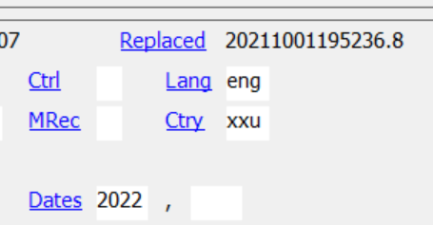
005 Date of Last Replace (Replaced)
System supplied
16 characters:
yyyymmddhhmmss.f
The date changes with replace transactions online or with changes made via batch processes
Plays no role in matching
Indexed in the Update Date (up: in Connexion and dr: in WorldShare) index
Notes:
The Replaced Date is sixteen characters and system supplied. Year, month, day, hour, minute, second, with the .f being a fraction of a second, thus being a decimal number. This resides in the 005 field while displaying as part of the Fixed field. When you replace a record online, this date changes. Or, when a batch process makes a change to the record, this date changes. It is indexed in the Update Date index, which is searched with 8 character dates, using year month and day. If you are trying to find records that were updated in WorldCat within a specific timeframe, this index can be very helpful.
And now over to Jay for the last grouping of elements for today.

Slide 25
Introduction to Field 006
008 | 006 | BKS | CNR | COM | MAP | MIX | REC | SCO | VIS
 | 0 | a, t | s | m | e, f | p | i, j | c, d | g, k, o, r
18 | 1 | Ills | Freq |  | Relf |  | Comp | Comp | Time
19 | 2 |  | Regl
20 | 3 |  |  |  |  |  | FMus | FMus
21 | 4 |  | SrTp |  |  |  | Part | Part
22 | 5 | Audn | Orig | Audn | Proj |  | Audn | Audn | Audn
23 | 6 | Form | Form | Form |  | Form | Form | Form
24 | 7 | Cont | EntW |  |  |  | AccM | AccM
25 | 8 |  | Cont |  | CrTp
26 | 9 |  |  | File
27 | 10
28 | 11 | GPub | GPub | GPub | GPub |  |  |  | GPub
29 | 12 | Conf | Conf |  | Form |  |  |  | Form
30 | 13 | Fest |  |  |  |  | LTxt | LTxt
31 | 14 | Indx |  |  | Indx
32 | 15
33 | 16 | LitF | Alph |  | SpFm |  | TrAr | TrAr | Tmat
34 | 17 | Biog | S/L |  |  |  |  |  | Tech
Field 006 is extension of field 008 when resource has multiple characteristics, including for:
Accompanying materials
Continuing Resource aspects of nontextual Continuing Resources
Electronic aspects of online resources
Field 006 corresponds to field 008/18-34
Notes:
Introduction to Field 006
Field 006 functions as an extension of field 008 when the resource represented by the record has multiple format characteristics. Think of field 006 as an additional fixed field, containing a subset of the positions defined in field 008, specifically positions 18 through 34, enabling a cataloger to code for characteristics beyond those already accounted for in the Leader and field 008. Common instances include accompanying materials, the Continuing Resource aspects of nontextual Continuing Resources, and the electronic aspects of online resources.
In MARC, the eighteen positions in field 006 (listed in column 2) correspond to the Type Code in the first byte (006/00) (listed in the first row below the header) followed by the seventeen positions that vary according to bibliographic format in field 008 positions 18 through 34 (listed in column 1). Covering every element in the fixed field in a single Virtual AskQC Office Hours session was impossible, so we tried to find a logical way to break it into two sessions. The least problematic solution we could come up with had us covering the Leader elements, field 001, field 005, and the field 008 positions common to all formats, that is, field 008/00-17 and 008/35-39, in this first session. But that left us with a lopsided sixteen elements in session one and about thirty-one in session two. Roughly two-thirds of those thirty-one elements are defined for only one bibliographic format and about half of the reminder are defined only in the MARC 21 Music format, which OCLC divided into Scores and Sound Recordings.
In this concluding section of this VAOH session, we will deal with most of the 008/006 elements that are applicable to more than one bibliographic format. The remaining elements, most of which apply to only a single format, plus those that apply to both Scores and Sound Recordings, will be dealt with a future session during 2022.

Slide 26
Introduction to Field 006
Field 006 elements identified by position
Input and display of field 006 vary by WorldCat interface and selected options
Each field 006 element has same input standard and defined codes as its corresponding field 008, except:
006/00 Form of Material corresponds to Leader/06 Type of Record
In 006/00, Continuing Resource is code s
Field 006 transfers if its bibliographic format is not already represented on retained record
BKS | a Language material | t Manuscript language material
CNR | s Serial/Integrating resource | --
COM | m Computer file | --
MAP | e Cartographic material | f Manuscript cartographic material
MIX | p Mixed materials | --
REC | j Musical sound recording | i Nonmusical sound recording
SCO | c Notated music | d Manuscript notated music
VIS | g Projected medium | k 2D nonprojectable graphic
 |  | o Kit
 |  | r 3D artifact/Object
Notes:
Introduction to Field 006
As with the elements in the Leader and field 008, those in field 006 are identified by position. The input and display of field 006 elements vary by interface and selected options. In a raw MARC 21 record, field 006 does not have indicators or subfield codes.
Each element in field 006 has the same input standard and the same defined codes as the corresponding element in field 008, with one exception. Field 006 position 00, Form of Material, corresponds to Leader/06, Type of Record, and determines the configuration of the rest of field 006. Field 006 Form of Material codes are the same as Leader/06 Type codes except that in field 006 position 00, Continuing Resources are represented by code s (highlighted in yellow). In the table, the center column lists the default value for each Form of Material and the righthand column lists any alternative Form of Material values that may be used when appropriate.
Of all the elements we are discussing in this session, only field 006 is eligible to transfer from a deleted record to a retained record. Any occurrences of field 006 whose Form of Material (that is, bibliographic format) is not already represented on the retained record, either in its Leader/06 or the first byte (006/00) of one of its fields 006 will transfer to the retained record. Field 006 will not transfer to a CONSER authenticated record.

Slide 27
008/22, 006/05 Target Audience (Audn)
Valid in the following formats: BKS, COM, REC, SCO, VIS
Optional, one-character code
May be edited
Default: Blank
Intellectual level of the audience for whom the resource is intended
Does not factor into matching
Indexed:
mt: Material Type Word Index
mt= Material Type Phrase Index
Only the juvenile values are indexed
008 210322s2020 caunnnndqr l n eng d
Notes:
008/22, 006/05 Target Audience (Audn)
Target Audience codes the intellectual level of the audience for whom the resource is intended. The element is an Optional one-character code. Several of the values are related to age or level of schooling (juvenile, preschool, adolescent), whereas others are more general (adult, specialized). This element is valid only in the Books, Computer Files, Sound Recordings. Scores, and Visual Materials formats.
The element may be edited. The default is Blank.
Target Audience does not factor into matching. Only the juvenile values are indexed in the Material Type Word and Phrase indexes.

Slide 28
008/23, 006/06 Form of Item (Form) (BKS, CNR, COM, MIX, REC, SCO) 008/29, 006/12 Form of Item (Form) (MAP, VIS)
Mandatory, one-character code
May be edited
Default: Blank
Form of the material being described
Microforms
Large print
Braille
Online or tangible electronic
Plays an important part in matching
Indexed:
mt: Material Type Word Index
mt= Material Type Phrase Index
mf: Microform Word Index
008 210322s2020 caunnnndqr l n eng d
Notes:
008/23, 006/06 Form of Item (Form) (BKS, CNR, COM, MIX, REC, SCO) 008/29, 006/12 Form of Item (Form) (MAP, VIS)
Unlike most of the other elements in field 008, Form of Item is either one of two positions depending upon the bibliographic format. In Books, Continuing Resources, Computer Files, Mixed Materials, Sound Recordings, and Scores, Form of Item is field 008 position 23 (and field 006 position 06). In Maps and Visual Materials, Form of Item is field 008 position 29 (and field 006 position 12).
Form is very important in matching. Among other things, Form helps distinguish different kinds of microforms, large print and Braille from regular print, and online resources from print resources. The Form values are indexed in the Material Type Word and Phrase indexes; additionally, the Microform values are indexed in the Microform Word Index.

Slide 29
008/28, 006/11 Government Publication (GPub)
Valid in the following formats: BKS, CNR, COM, MAP, VIS
Mandatory, one-character code
May be edited
Default: Blank
Indication that resource is published or produced by or for a government at any level or a subdivision of a government entity
Does not factor into matching
Indexed:
mt: Material Type Word Index
mt= Material Type Phrase Index
Indexed under international, national, state/province, or local, plus general GPub
008 190418t20192019njuc a s 1 eng c
Notes:
008/28, 006/11 Government Publication (GPub)
Government Publication is a one-character code that indicates whether the resource is published or produced by or for an international, national, state, provincial, or local government agency or by a subdivision of such an entity. The code also describes the jurisdictional level of the government agency associated with the resource.
This element is valid only in the Books, Continuing Resources, Computer Files, Maps, and Visual Materials formats. Coding is Mandatory and the default is blank. The element may be edited. Government Publication does not factor into matching. It is indexed in the Material Type Word and Phrase indexes, under both the general Government Publication Material Type (gpb) and one of its four more specific Material Types: International (igp), National (ngp), State or Province (sgp), or Local (lgp).

Slide 30
008/29, 006/12 Conference Publication (Conf)
Valid in the following formats: BKS, CNR
Optional, one-character code
May be edited
Defaults:
BKS: 0
CNR: Fill character
Indicates if the resource consists of the proceedings, reports, or summaries of a conference
Does not factor into matching
Indexed:
mt: Material Type Word Index
mt= Material Type Phrase Index
008 841207s1775 sp 000 0 lat
Notes:
008/29, 006/12 Conference Publication (Conf)
Conference Publication is a one-character code that indicates if the resource consists of the proceedings, reports, or summaries of a conference. It is Optional and is valid only in the Books and Continuing Resources formats. In the Books format, its default is 0 and in Continuing Resources, the default is a Fill Character. Conference Publication does not figure into matching, but it is indexed in the Material Type Word and Phrase Indexes.

Slide 31
008/31, 006/14 Index (Indx)
Valid in the following formats: BKS, MAP
Optional, one-character code
May be edited
Default: 0
Indicates if a resource or its accompanying material has an index to its own contents, including a location index or gazetteer
Does not factor into matching
Index is not indexed
Ironic, isn’t it?
008 190418t20192019njuc a s 1 eng c
Notes:
008/31, 006/14 Index (Indx)
The Index element, valid only in the Books and Maps formats, is an Optional one-character code that indicates if a resource or its accompanying material has an index to its own contents, In the case of a map, that may include a location index or a gazetteer. This information is usually derived from the title, statement of responsibility, or a note. Index may be edited but does not figure into matching. And in one of the major ironies built into WorldCat, the Index element itself is not indexed.

Slide 32
On the call today
Shanna Griffith
Cynthia Whitacre
Jay Weitz
Database Specialist
Senior Metadata Operations Manager
Senior Consulting Database Specialist
Hayley Moreno
Charlene Morrison
Database Specialist
Database Specialist

Slide 33
Thank you!
November Virtual AskQC Office Hours
Cataloging children's materials
Tuesday, 9 Nov. at 10:00 AM Eastern
Thursday, 18 Nov. at 4:00 PM Eastern
Registration and session links available at oc.lc/askqc
Send cataloging policy questions at any time to askqc@oclc.org
Photo by Eric Rothermel on Unsplash

